Slide 1
Syntactic Analysis and Parsing
W266: Natural Language Processing

Slide 2
Peeking ahead...
Week 1- 2: NN Basics & Training
Week 3: Classification & Sentiment
Week 4: Part of Speech + Parsing
Week 5: Convolutional Neural Networks (CNNs)
Week 6 - 7: Language Models
Project Proposal Due Feb 6
Week 8: Machine Translation
Week 9: Advanced MT: Transformers & Transfer Learning
Week 10: Entities/Information Extraction
Week 11: Summarization and a touch of question answering
Week 12: Document Classification
Week 13: Information Retrieval

Slide 3
Announcements
Assignment 3 (Embeddings) - released this past Saturday 01/23
Due Sunday, Jan 31 (Tuesday 2/2 if you use late days)
Assignment 4 to be released Saturday 02/06.
Paper reading sessions:
This Friday 1/29 5:40 pm PST
Mark: Climbing toward NLU: On Meaning, Form, and Understanding in the Age of Data and A robot wrote this entire article. Are you scared yet, human? GPT-3
Next week: None
Project Proposals - Due 02/06!
Questions?
Concerns?

Slide 4
This week...
Parts of Speech
Dependency Parsing
Intuition
Transition-Based Parsing
Beam Search
Constituency Parsing
Intuition
CKY Parsing

Slide 5
Recap...
W266: Natural Language Processing

Slide 6
Neural Nets
Sigmoid Or Softmax
Output layer
(“softmax layer”)
Affine
Nonlinearity
Fully-connected layer 2
Affine
z = xW + b
dim(x) = k
dim(z) = m
shape(W) = k x m
dim(b) = m
Affine
Nonlinearity
Fully-connected layer 1
Affine
x₁ x₂
Notes:
Not to be confused with how batteries work

Slide 7
Combining Supervised+Unsupervised
Sigmoid Or Softmax
Supervised task Trains hidden and output layers
Unsupervised task Trains word embeddings
Why?
More unsupervised than supervised data
Word level task transfer
Effectiveness depends on task and quantity of supervised data.
Affine
Nonlinearity
Supervised (e.g., Sentiment)
Affine
Sum vectors
(“bag of words”)
+
e₁ e₂ e₃ e₄ e₅
Unsupervised (e.g., Word2Vec)
w₁ w₂ w₃ w₄ w₅

Slide 8
Parsing, why?
W266: Natural Language Processing

Slide 9
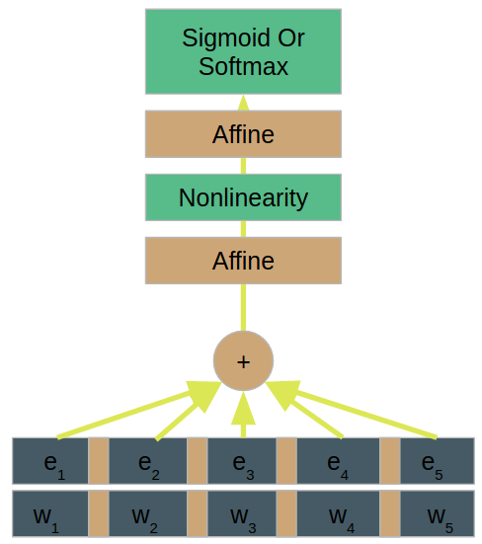
Let’s step back...
What info did we (not) give the network?
...
‘I’ ‘bank’ ‘into’ ‘a’ ‘turn’
‘I’ ‘will’ ‘visit’ ‘Washington’ ‘tomorrow’

Slide 10
Let’s step back...
What info did we (not) give the network?
Whether tokens are nouns, verbs,..? No
Whether tokens are entities (locations, persons, etc...)? No
What the grammatical structure of the sentence is? No
...
Could that be useful?
Certainly could!
Pre-(transformer)-neural-nets: ESSENTIAL!
‘I’ ‘bank’ ‘into’ ‘a’ ‘turn’
‘I’ ‘will’ ‘visit’ ‘Washington’ ‘tomorrow’

Slide 11
Parsing Use Cases
Goal:
Given a sentence, what are roles and relations of words?
Grade school: NOUN, PRONOUN, ADJ, VERB, SUBJECT, OBJECT…
Why is this useful? (Some tricky examples)
“Microsoft to buy Google competitor Duck Duck Go in the coming weeks.”
“I saw an elephant in my pyjamas this morning.”
“They will not necessarily enjoy the movie.”
Notes:
Duck Duck Go is the object, Google competitor a modifier
I was wearing the pyjamas, not the elephant
Not necessarily negates enjoy the movie

Slide 12
Parsing Use Cases
Identify grammatical phrases (rather than n-grams)
Identify entities (proper nouns)
Identify relations between objects (modifiers and prepositional phrases)
Identify subject-verb-object triples
Count occurences for analytics
Leverage as features for other processing
Leverage tree structure for other processing

Slide 13
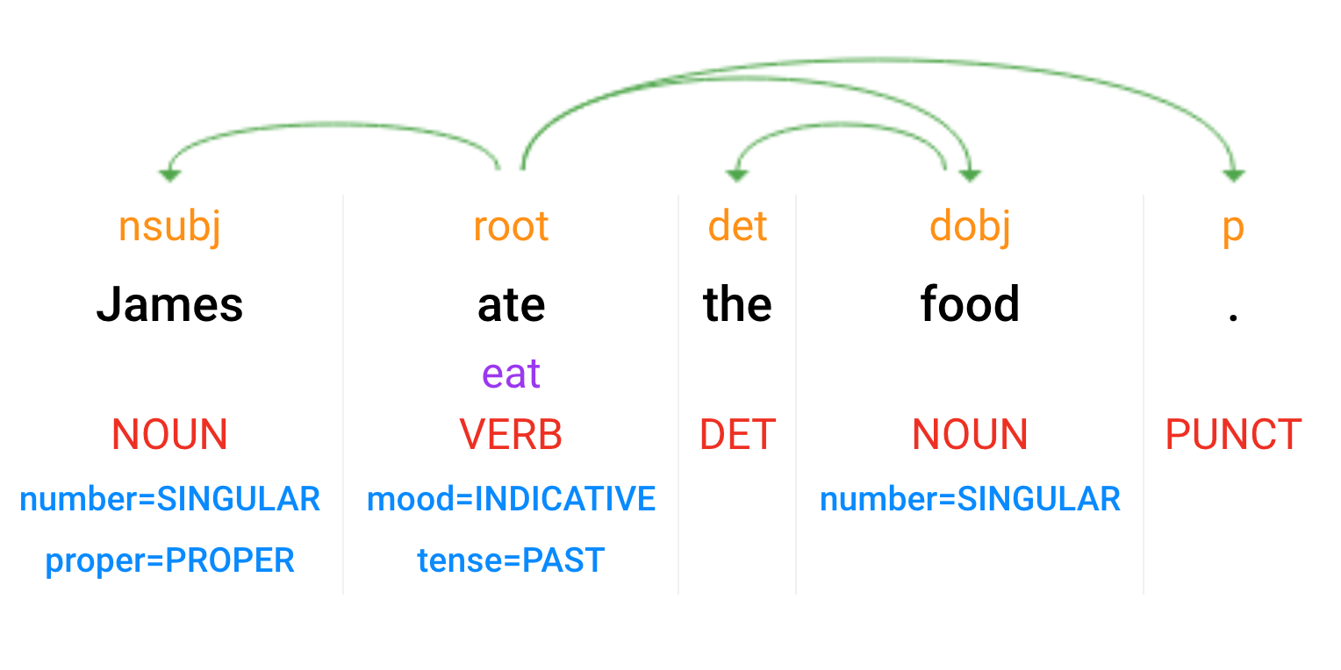
Syntactic Analysis
Parsey McParseface: https://cloud.google.com/natural-language/
Dependency Parse
(+ dependency types)
Lemmas
Part-of-Speech Tags
Morphology
Notes:
Scroll down for the test console

Slide 14
Part of Speech Tagging

Slide 15
Part of Speech
Goal:
Given a sentence, what role does each word play?
Grade school: NOUN, PRONOUN, ADJ, VERB, ...
Why is this useful?

Slide 16
Part of Speech
Goal:
Given a sentence, what role does each word play?
Grade school: NOUN, PRONOUN, ADJ, VERB, ...
Why is this useful?
Resolve ambiguity:
“Time flies.v like an arrow, fruit flies.n like a banana.”
“bank.v into a turn” / “go to the bank.n”
Abstract from words -> syntactic patterns
Useful as input to other systems

Slide 17
Universal Dependencies Tagset
http://universaldependencies.org/u/pos/index.html
ADJ: adjective
ADP: adposition
ADV: adverb
AUX: auxiliary
CCONJ: coordinating conjunction
DET: determiner
INTJ: interjection
NOUN: noun
NUM: numeral
PART: particle
PRON: pronoun
PROPN: proper noun
PUNCT: punctuation
SCONJ: subordinating conjunction
SYM: symbol
VERB: verb
X: other
Notes:
Penn Treebank has another commonly used tagset, with more categories: http://www.surdeanu.info/mihai/teaching/ista555-fall13/readings/PennTreebankConstituents.html#Word

Slide 18
How Can We Build a Simple POS Classifier?
Let’s use what we know and brainstorm..
Architecture:
Input: ..
...
Limitations of proposed architecture?
...

Slide 19
Parsing
Notes:
Dependency vs phrase structure grammars & probabilistic CFGs

Slide 20
2 Types of Parsing: Dependency Parsing

Slide 21
2 Types of Parsing: Constituency Parsing
S
Phrase-Structure Parsing
VP
NP
NP
NNP
VBD
DT
NN
James
ate
the
food

Slide 22
Parsing: Overview
Parsing Task: tree-structured prediction
Types of Parsing:
Dependency
Constituency / phrase-structure
(Semantic)
Parsing Techniques / Algorithms:
Transition-based
Graph-based
Chart-based
Similar goal: find the best tree. Different formalisms, but similar algorithms used for all types.
Notes:
Also top-down vs. bottom-up. We’ll mostly consider bottom-up in this class, but top-down algorithms are similar.

Slide 23
Dependency Parsing

Slide 24
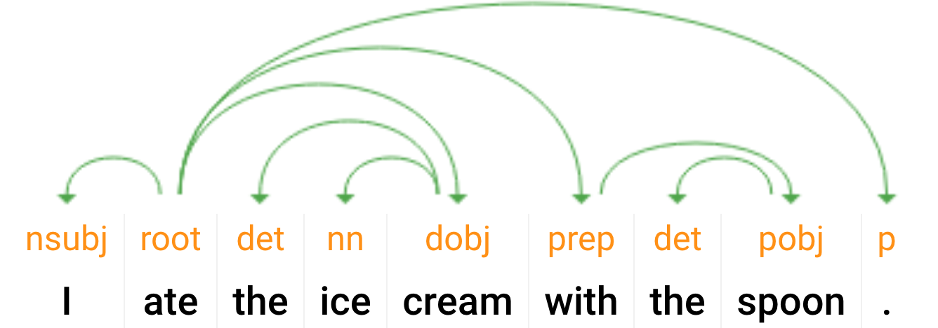
Parsing!
What’s the goal?
I ate the ice_cream with the spoon.
I ate the ice_cream with the cherry.
Notes:
“Pasta: With chopsticks vs. with sauce” in async

Slide 25
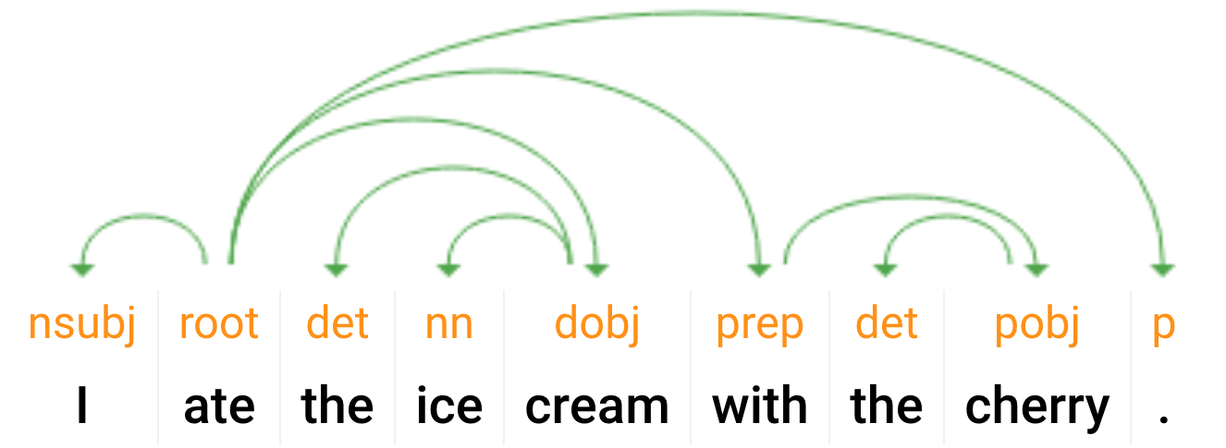
Parsing!
What’s the goal?
I ate the ice_cream with the spoon.
I ate the ice_cream with the cherry.
Notes:
“Pasta: With chopsticks vs. with sauce” in async

Slide 26
Formal definition of Dependency Parsing
Formally, a dependency structure for a given sentence is a directed graph originating out of a unique and artificially inserted root node.
In the most common case, every valid dependency graph has the following properties,
It is weakly connected (in the directed sense).
Each word has exactly one incoming edge in the graph (except the root, which has no incoming edge).
There are no cycles.

Slide 27
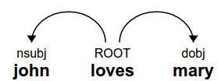
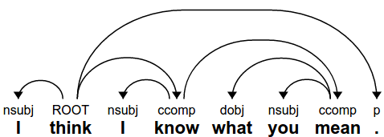
Examples of dependency trees
Each word has an incoming edge - except ROOT (not drawn)
The graphs are connected
There are function labels (which we sometimes leave out)
Notes:
ROOT (loves) ->(nsubj) john
->(dobj) mary

Slide 28
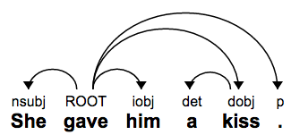
Some linguistic phenomena you can capture
Who did what to whom:
Subject, direct object, indirect object

Slide 29
Some linguistic phenomena you can capture
Who did what to whom:
Subject, direct object, indirect object

Slide 30
Some linguistic phenomena you can capture
Who did what to whom:
Subject, direct object, indirect object

Slide 31
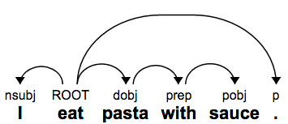
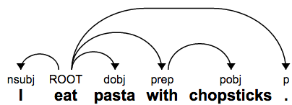
Prepositional phrase attachment
Eat → with → chopsticks vs pasta → with → sauce

Slide 32
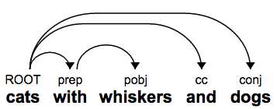
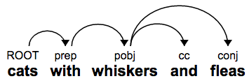
Coordination
In one case, we have cats and dogs, where the cats have whiskers
In the other, we have cats who have both whiskers and fleas
Notes:
More examples and definitions - https://nlp.stanford.edu/software/dependencies_manual.pdf

Slide 33
Transition-Based Parsing

Slide 34
SyntaxNet / Parsey McParseface
Animation from Google Research Blog

Slide 35
Transition based parsing
Mechanism: build parse tree by sequence of actions (transitions)
Set-up (state):
A buffer initialized with the words
A stack to store state:
Words under consideration for more edges
Dependency arcs (edges)
The partially-constructed tree
ROOT
John
loves
Mary
.
Stack
Buffer
Notes:
Related to algorithms for parsing deterministic grammars such as programming languages (e.g. LALR parsers). More generally, any context-free grammar (we’ll discuss next week) can be parsed using a transition system.

Slide 36
Transition based parsing
Mechanism: build parse tree by sequence of actions (transitions)
Arc-Standard parsing:
Shift: consume from buffer, push to stack
Left-arc: add left edge
Right-arc: add right edge
ROOT
John
loves
Mary
.
Stack
Buffer

Slide 37
Arc-Standard Parsing Example
Arc-Standard parsing:
Shift: consume from buffer, push to stack
Left-arc: add left edge
Right-arc: add right edge
ROOT
John
loves
Mary
.
Stack
Buffer

Slide 38
Arc-Standard Parsing Example
Arc-Standard parsing:
Shift: consume from buffer, push to stack
Left-arc: add left edge
Right-arc: add right edge
ROOT
John
loves
Mary
.
Stack
Buffer

Slide 39
Arc-Standard Parsing Example
Arc-Standard parsing:
Shift: consume from buffer, push to stack
Left-arc: add left edge
Right-arc: add right edge
ROOT
John
loves
Mary
.
Stack
Buffer

Slide 40
Arc-Standard Parsing Example
Arc-Standard parsing:
Shift: consume from buffer, push to stack
Left-arc: add left edge
Right-arc: add right edge
Remove child from stack
ROOT
John
loves
Mary
.
Stack
Buffer

Slide 41
Arc-Standard Parsing Example
Arc-Standard parsing:
Shift: consume from buffer, push to stack
Left-arc: add left edge
Right-arc: add right edge
Remove child from stack
ROOT
John
loves
.
Mary
Stack
Buffer

Slide 42
Arc-Standard Parsing Example
Arc-Standard parsing:
Shift: consume from buffer, push to stack
Left-arc: add left edge
Remove child from stack
Right-arc: add right edge
nsubj
dobj
ROOT
John
loves
.
Mary
Stack
Buffer

Slide 43
Arc-Standard Parsing Example
Arc-Standard parsing:
Shift: consume from buffer, push to stack
Left-arc: add left edge
Remove child from stack
Right-arc: add right edge
ROOT
loves
.
John
Mary
Stack
Buffer

Slide 44
Arc-Standard Parsing Example
Arc-Standard parsing:
Shift: consume from buffer, push to stack
Left-arc: add left edge
Right-arc: add right edge
ROOT
loves
.
John
Mary
Stack
Buffer

Slide 45
Arc-Standard Parsing Example
Arc-Standard parsing:
Shift: consume from buffer, push to stack
Left-arc: add left edge
Right-arc: add right edge
Remove child from stack
ROOT
loves
.
John
Mary
Stack
Buffer

Slide 46
Arc-Standard Parsing Example
Arc-Standard parsing:
Shift: consume from buffer, push to stack
Left-arc: add left edge
Right-arc: add right edge
Remove child from stack
ROOT
loves
John
Mary
.
Stack
Buffer

Slide 47
Arc-Standard Parsing Example
Arc-Standard parsing:
Shift: consume from buffer, push to stack
Left-arc: add left edge
Right-arc: add right edge
Remove child from stack
ROOT
loves
Stack
Buffer
John
Mary
.

Slide 48
Arc-Standard Parsing Example
Arc-Standard parsing:
Shift: consume from buffer, push to stack
Left-arc: add left edge
Right-arc: add right edge
ROOT
John
loves
Mary
.
Notes:
Read off parse tree from edges.

Slide 49
Transition-Based Parsing: Analysis
“Shift-reduce” parsing:
Shift: (shift) move from buffer to stack
Reduce: (left-arc, right-arc) add edges, and remove elements from stack
For N tokens:
O(N) shift operations (one for each token)
O(N) reduce operations (one for each edge)
O(N) = linear time parsing! (if you can choose the right transitions)

Slide 50
Arc-Standard vs. Arc-Eager
Arc-Standard:
Shift:
Pop buffer[0], push onto stack
Left-arc:
Add edge stack[-2] ← stack[-1]
Remove stack[-2] from stack
Right-arc:
Add edge stack[-2] → stack[-1]
Remove stack[-1] from stack
Guaranteed to produce a single tree
Arc-Eager:
Shift:
Pop buffer[0], push onto stack
Left-arc:
Add edge stack[-1] ← buffer[0]
Remove stack[-1] from stack
Right-arc:
Add edge stack[-1] → buffer[0]
Pop buffer[0], push onto stack
Reduce:
Remove stack[-1] from stack
Can produce forest (multiple trees)
Some sequences yield the same tree / forest (spurious ambiguity)

Slide 51
Transition-Based Parsing: Analysis 2
“Shift-reduce” parsing:
Shift: (shift) move from buffer to stack
Reduce: (left-arc, right-arc) add edges, and remove elements from stack
Actions are irreversible! Cannot undo with other transitions.
Corollary: must choose correct* action every time!
* May be more than one correct action! (spurious ambiguity)
How do you learn the right one?

Slide 52
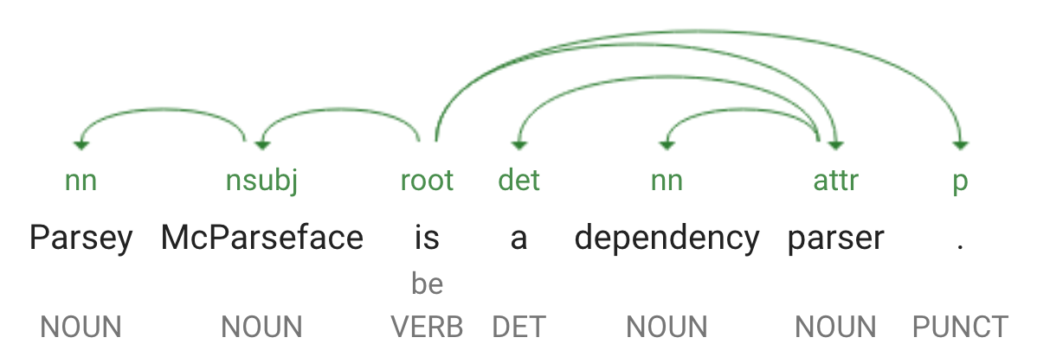
Training?
Training data
A large number of sentences with edges between their words
Fundamental question:
How to apply machine learning?
Answer: An Oracle!
Notes:
But wait, what if multi-path? Dynamic oracle.

Slide 53
How to choose transitions?
Multi-class prediction:
Inputs: state = {stack, buffer, other features}
Targets: transitions = {shift, left-arc, right-arc}
Classifier: score(a_{i} | state_{i}) at step i
Rule-based, SVM, NN, etc.
Training:
Predict “gold” actions (from true tree)
Or: “dynamic oracle” rewards good actions
score(Shift)
score(Left-Arc)
score(Right-Arc)
h2
h1
Stack features
Buffer features
ROOT
John
loves
Mary
.
Stack
Buffer

Slide 54
Inference: protecting against mistakes
Performing inference is easy:
Initialize the stack & buffer
Apply model to determine best next transition, apply it, repeat!
What is “best”?
What if two are “close”?
Commit entirely to one?

Slide 55
Beam Search

Slide 56
Beam Search - Problem Statement
Correct parsing: “Shift Shift L-Arc Shift R-Arc”
System correctly generated: “Shift Shift L-Arc” ...
… but next action probability distribution:
P₄(Shift) = 0.41
P₄(L-Arc) = 0.43
What do you pick?

Slide 57
Beam Search - Problem Statement
Correct parsing: “Shift Shift L-Arc Shift R-Arc”
System correctly generated: “Shift Shift L-Arc” ...
… but next action probability distribution:
P₄(Shift) = 0.41
P₄(L-Arc) = 0.43
‘L-Arc’ is highest, so we should(?) pick that one...
… but what if
∀_{X}P₄₅(‘L-Arc’, X) << P₄₅(‘Shift’, ‘R-Arc’)? Potentially sub-optimal! Too late!

Slide 58
What Can We Do?
Keep only top candidate at each step?
That is the issue… efficient but highly non-optimal
Keep all candidates at all steps?
Optimal! But if vocab length (or in general number of classes) V, sentence length L … how many items to keep?
V^{L} ! Oy… impossible

Slide 59
Beam Search To The Rescue
Beam Search: Don’t fully commit.. leave fixed number of options in play !
Keep Top N candidates at each step i…
… calculate for each candidate the next word’s probability distribution, keep top N of those
… that gives N*L new combined candidates at step i+1
… and keep Top N of those
… keep doing this Simple!

Slide 60
Beam Search - Example (N = 2)
Step 1
P(Shift) = 0.07 P(L-Arc) = 0.04 P(R-Arc) = 0.01
Poor example, ‘Shift’ is always first. But this illustrates the point...

Slide 61
Beam Search - Example (N = 2)
Step 1
P(Shift) = 0.07 P(L-Arc) = 0.04 P(R-Arc) = 0.01
X

Slide 62
Beam Search - Example (N = 2)
Step 2
P(Shift) = 0.07 P(Shift, Shift) = 0.010 P(L-Arc) = 0.04 P(L-Arc, Shift) = 0.006 P(Shift, L-Arc) = 0.002 P(Shift, R-arc) = 0.001
….

Slide 63
Beam Search - Example (N = 2)
Step 2
P(Shift) = 0.07 P(Shift, Shift) = 0.010 P(L-Arc) = 0.04 P(L-Arc, Shift) = 0.006 P(Shift, L-Arc) = 0.002 P(Shift, R-arc) = 0.001
….
X
X
X

Slide 64
Beam Search - Example (N = 2)
Step 3
P(Shift) = 0.07 P(Shift, Shift) = 0.010 P(L, S, L) = 0.0011 P(L-Arc) = 0.04 P(L-Arc, Shift) = 0.006 P(S, S, L) = 0.00034 P(S, S, R) = 0.0002 P(S, S, S) = 0.0001
….
X
X
X

Slide 65
Beam Search - Example (N = 2)
Step 3
P(Shift) = 0.07 P(Shift, Shift) = 0.010 P(L, S, L) = 0.0011 P(L-Arc) = 0.04 P(L-Arc, Shift) = 0.006 P(S, S, L) = 0.00034
Not ‘optimal’ but very good and stable memory need
Beam size N: tunable hyper-parameter!

Slide 66
Constituency Parsing

Slide 67
Parsing: Overview
Parsing: tree-structured prediction
Types of Parsing:
Dependency
Constituency / phrase-structure
(Semantic)
Parsing Techniques / Algorithms:
Transition-based
Graph-based
Chart-based
Similar goal: find the best tree. Different formalisms, but similar algorithms used for all types.
Notes:
Also top-down vs. bottom-up. We’ll mostly consider bottom-up in this class, but top-down algorithms are similar.

Slide 68
2 Types of Parsing: Constituency Parsing
S
Phrase-Structure Parsing
VP
NP
NP
NNP
VBD
DT
NN
James
ate
the
food

Slide 69
Context-Free Grammars
Grammar rules: A → B C, A → “a”
Apply by recursive expansion of symbols (nonterminals)
S → NP VP
NP → NNP
VP → VBD NP
NP → DT NN
NNP → “James”
VBD → “ate”
DT → “the”
NN → “food”
S
VP
NP
NP
NNP
VBD
DT
NN
James
ate
the
food

Slide 70
Context-Free Grammars
Symbol types:
Nonterminals (constituents), Preterminals (POS tags), Terminals (types)
S → NP VP
NP → NNP
VP → VBD NP
NP → DT NN
NNP → “James”
VBD → “ate”
DT → “the”
NN → “food”
S
VP
NP
NP
NNP
VBD
DT
NN
James
ate
the
food

Slide 71
Two important considerations...
Ambiguity: what is “score”?
c(A -> B C)
weight(A -> B C) = log(p(A -> B C)) = log( c(A -> B C) / c(A) )
Chomsky Normal Form (CNF)
S
VP
NP
NP
NNP
VBD
DT
NN
James
ate
the
food

Slide 72
“Score”: Probabilistic Context-Free Grammars
Grammar rules: A → B C, A → “a”
Each rule has a probability associated with the production
Normalized by the left hand side
S → NP VP [1.0]
NP → NNP [0.6]
NP → DT NN [0.4]
VP → VBD NP [1.0]
NNP → “James” [...]
VBD → “ate”
DT → “the”
NN → “food”
S
VP
NP
NP
NNP
VBD
DT
NN
James
ate
the
food

Slide 73
Chomsky Normal Form
Grammar rules:
A → B C
A → “a”
(or, S → epsilon)
Not allowed:
A → B C D
No problem:
A → B E
E → C D (often the name “C|D” is used instead of “E”)

Slide 74
Chomsky Normal Form
Grammar rules:
A → B C
A → “a”
(or, S → epsilon)
Not allowed:
A → B
B → C
No problem:
A → B
A → C

Slide 75
Chomsky Normal Form
Grammar rules:
A → B C
A → “a”
(or, S → epsilon)
Convenience function in nltk to convert a grammar to CNF.

Slide 76
Chart-Based Parsing
The Chart: dynamic programming table
n(n+1)/2 cells
Represent spans [i,j)
Entries: subtree derivations
Example:
(ROOT (S (NP (NNP James)) (VP (VBD ate) (NP (DT the) (NN food)))))
S
VP
NP
NP/NNP
VBD
DT
NN
James
ate
the
food
Notes:
(1 + 2 + 3 + …. + n) = n(n+1)/2

Slide 77
Chart-Based Parsing
The Chart: dynamic programming table
n(n+1)/2 cells
Represent spans [i,j)
Entries: subtree derivations
(for each symbol)
Top cell: full derivation
CKY Algorithm:
Variant of Viterbi decoding
Assume binary tree and grammar
For each cell, consider L, R subtrees
Choose best candidate
Store backpointers
S
VP
NP
NP/NNP
VBD
DT
NN
James
ate
the
food

Slide 78
Chart-Based Parsing
CKY Algorithm:
Token cells: [i, i+1) (assume have POS tags)
Store best score(i,j,X) for symbol X
For each cell [i,j), bottom-up:
For each rule (A → B C):
For each split i ﹤ ℓ < j:
x = score(i,ℓ,B) + score(ℓ,j,C)
+ weight(A → B C)
If x > score(i,j,A):
score(i,j,A) = x
children(i,j,A) = [(i,ℓ,B),
(ℓ,j,C)]
S
VP
X
NP
NP/NNP
VBD
DT
NN
James
ate
the
food
Notes:
X -> VBD DT
Y -> X NN
Note NP/NNP: there’s an unary rule NP -> NNP that we have to apply in-cell.
i=0, j=2
i=0, l=1, j=2
i=0, l=2, j=2

Slide 79
CKY Algorithm
S → NP VP
NP → NNP
VP → VBD NP
NP → DT NN
NNP → “James”
VBD → “ate”
DT → “the”
NN → “food”
Token cells: [i, i+1) (assume have POS tags)
Store best score(i,j,X) for symbol X
For each cell [i,j), bottom-up:
For each rule (A → B C):
For each split i ﹤ ℓ < j:
x = score(i,ℓ,B) + score(ℓ,j,C)
+ weight(A → B C)
If x > score(i,j,A):
score(i,j,A) = x
children(i,j,A) = [(i,ℓ,B),
(ℓ,j,C)]
?
?
?
?
James
ate
the
food
0
1
2
3
4

Slide 80
CKY Algorithm
S → NP VP
NP → NNP
VP → VBD NP
NP → DT NN
NNP → “James”
VBD → “ate”
DT → “the”
NN → “food”
Token cells: [i, i+1) (assume have POS tags)
Store best score(i,j,X) for symbol X
For each cell [i,j), bottom-up:
For each rule (A → B C):
For each split i ﹤ ℓ < j:
x = score(i,ℓ,B) + score(ℓ,j,C)
+ weight(A → B C)
If x > score(i,j,A):
score(i,j,A) = x
children(i,j,A) = [(i,ℓ,B),
(ℓ,j,C)]
NNP
VBD
DT
NN
James
ate
the
food
0
1
2
3
4

Slide 81
CKY Algorithm
S → NP VP
NP → NNP
VP → VBD NP
NP → DT NN
NNP → “James”
VBD → “ate”
DT → “the”
NN → “food”
Token cells: [i, i+1) (assume have POS tags)
Store best score(i,j,X) for symbol X
For each cell [i,j), bottom-up:
For each rule (A → B C):
For each split i ﹤ ℓ < j:
x = score(i,ℓ,B) + score(ℓ,j,C)
+ weight(A → B C)
If x > score(i,j,A):
score(i,j,A) = x
children(i,j,A) = [(i,ℓ,B),
(ℓ,j,C)]
NP/NNP
VBD
DT
NN
James
ate
the
food
0
1
2
3
4

Slide 82
CKY Algorithm
S → NP VP
NP → “James”
VP → VBD NP
NP → DT NN
VBD → “ate”
DT → “the”
NN → “food”
Token cells: [i, i+1) (assume have POS tags)
Store best score(i,j,X) for symbol X
For each cell [i,j), bottom-up:
For each rule (A → B C):
For each split i ﹤ ℓ < j:
x = score(i,ℓ,B) + score(ℓ,j,C)
+ weight(A → B C)
If x > score(i,j,A):
score(i,j,A) = x
children(i,j,A) = [(i,ℓ,B),
(ℓ,j,C)]
NP
VBD
DT
NN
James
ate
the
food
0
1
2
3
4

Slide 83
CKY Algorithm
S → NP VP
NP → NNP
VP → VBD NP
NP → DT NN
NNP → “James”
VBD → “ate”
DT → “the”
NN → “food”
Token cells: [i, i+1) (assume have POS tags)
Store best score(i,j,X) for symbol X
For each cell [i,j), bottom-up:
For each rule (A → B C):
For each split i ﹤ ℓ ≤ j:
x = score(i,ℓ,B) + score(ℓ,j,C)
+ weight(A → B C)
If x > score(i,j,A):
score(i,j,A) = x
children(i,j,A) = [(i,ℓ,B),
(ℓ,j,C)]
?
NP/NNP
VBD
DT
NN
James
ate
the
food
0
1
2
3
4

Slide 84
CKY Algorithm
S → NP VP
NP → NNP
VP → VBD NP
NP → DT NN
NNP → “James”
VBD → “ate”
DT → “the”
NN → “food”
Token cells: [i, i+1) (assume have POS tags)
Store best score(i,j,X) for symbol X
For each cell [i,j), bottom-up:
For each rule (A → B C):
For each split i ﹤ ℓ ≤ j:
x = score(i,ℓ,B) + score(ℓ,j,C)
+ weight(A → B C)
If x > score(i,j,A):
score(i,j,A) = x
children(i,j,A) = [(i,ℓ,B),
(ℓ,j,C)]
NP
NP/NNP
VBD
DT
NN
James
ate
the
food
0
1
2
3
4

Slide 85
CKY Algorithm
S → NP VP
NP → NNP
VP → VBD NP
NP → DT NN
NNP → “James”
VBD → “ate”
DT → “the”
NN → “food”
Token cells: [i, i+1) (assume have POS tags)
Store best score(i,j,X) for symbol X
For each cell [i,j), bottom-up:
For each rule (A → B C):
For each split i ﹤ ℓ ≤ j:
x = score(i,ℓ,B) + score(ℓ,j,C)
+ weight(A → B C)
If x > score(i,j,A):
score(i,j,A) = x
children(i,j,A) = [(i,ℓ,B),
(ℓ,j,C)]
?
NP
NP/NNP
VBD
DT
NN
James
ate
the
food
0
1
2
3
4

Slide 86
CKY Algorithm
S → NP VP
NP → NNP
VP → VBD NP
NP → DT NN
NNP → “James”
VBD → “ate”
DT → “the”
NN → “food”
Token cells: [i, i+1) (assume have POS tags)
Store best score(i,j,X) for symbol X
For each cell [i,j), bottom-up:
For each rule (A → B C):
For each split i ﹤ ℓ ≤ j:
x = score(i,ℓ,B) + score(ℓ,j,C)
+ weight(A → B C)
If x > score(i,j,A):
score(i,j,A) = x
children(i,j,A) = [(i,ℓ,B),
(ℓ,j,C)]
?
NP
NP/NNP
VBD
DT
NN
James
ate
the
food
0
1
2
3
4

Slide 87
CKY Algorithm
S → NP VP
NP → NNP
VP → VBD NP
NP → DT NN
NNP → “James”
VBD → “ate”
DT → “the”
NN → “food”
Token cells: [i, i+1) (assume have POS tags)
Store best score(i,j,X) for symbol X
For each cell [i,j), bottom-up:
For each rule (A → B C):
For each split i ﹤ ℓ ≤ j:
x = score(i,ℓ,B) + score(ℓ,j,C)
+ weight(A → B C)
If x > score(i,j,A):
score(i,j,A) = x
children(i,j,A) = [(i,ℓ,B),
(ℓ,j,C)]
?
NP
NP/NNP
VBD
DT
NN
James
ate
the
food
0
1
2
3
4

Slide 88
CKY Algorithm
S → NP VP
NP → NNP
VP → VBD NP
NP → DT NN
NNP → “James”
VBD → “ate”
DT → “the”
NN → “food”
Token cells: [i, i+1) (assume have POS tags)
Store best score(i,j,X) for symbol X
For each cell [i,j), bottom-up:
For each rule (A → B C):
For each split i ﹤ ℓ ≤ j:
x = score(i,ℓ,B) + score(ℓ,j,C)
+ weight(A → B C)
If x > score(i,j,A):
score(i,j,A) = x
children(i,j,A) = [(i,ℓ,B),
(ℓ,j,C)]
VP
NP
NP/NNP
VBD
DT
NN
James
ate
the
food
0
1
2
3
4
Notes:
chart[(1,4)]
Split = 2
Look at chart[(1,2)] and chart[(2,4)]
In chart[(1,2)][VBD] -> tree_B = ProbabilisticTree(VBD, [“ate”], logprob=...)
In chart[(2,4)][NP] -> tree_C = ProbabilisticTree(NP, [ProbabilisticTree(DT, [“the”], …), ProbabilisticTree(NN, [“food”], …), …)
A = VP ?
…
A = NP ?
If new_score > chart[(i,j)][A].logprob(): # replace with new, better derivation (tree_A)
chart[(i,j)][A] = ProbabilisticTree(A, [tree_B, tree_C], logprob=new_score)

Slide 89
CKY Algorithm
S → NP VP
NP → NNP
VP → VBD NP
NP → DT NN
NNP → “James”
VBD → “ate”
DT → “the”
NN → “food”
Token cells: [i, i+1) (assume have POS tags)
Store best score(i,j,X) for symbol X
For each cell [i,j), bottom-up:
For each rule (A → B C):
For each split i ﹤ ℓ ≤ j:
x = score(i,ℓ,B) + score(ℓ,j,C)
+ weight(A → B C)
If x > score(i,j,A):
score(i,j,A) = x
children(i,j,A) = [(i,ℓ,B),
(ℓ,j,C)]
S
VP
NP
NP/NNP
VBD
DT
NN
James
ate
the
food
0
1
2
3
4

Slide 90
CKY Algorithm
Token cells: [i, i+1) (assume have POS tags)
Store best score(i,j,X) for symbol X
For each cell [i,j), bottom-up: O(n^2)
For each rule (A → B C): O(k^3)
For each split i ﹤ ℓ ≤ j: O(n)
x = score(i,ℓ,B) + score(ℓ,j,C)
+ weight(A → B C)
If x > score(i,j,A):
score(i,j,A) = x
children(i,j,A) = [(i,ℓ,B),
(ℓ,j,C)]
S
VP
NP
NP/NNP
VBD
DT
NN
James
ate
the
food
0
1
2
3
4

Slide 91
That’s It, Folks!
(See You Next Week For
Convolutional Neural Networks…)

Slide 92
Extra Slides

Slide 93
Inference: Beam Search
Choosing transitions as a search problem: what is the best path to my goal?
Goal: complete parse tree
Path: sequence of actions (transitions) {a₀,a₁,a₂,...}
“Best”: highest scoring (according to model score = ∑_{i} score(a_{i}) )
Greedy: pick highest scoring transition at each step
Beam search: keep “beam” of k top-scoring candidates (up to complete trees)
Can do this during training as well!
Notes:
In general, not possible to do exact inference for transition systems (too many possibilities). But, beam search works very well. Next week, we’ll look at the CKY algorithm, which uses DP for exact inference in parsing.

Slide 94
How Can We Build a Simple POS Classifier?
Architecture:
Input: ..
...
Limitations of proposed architecture?
...

Slide 95
Bert vs.(?) the NLP Pipeline
“BERT Rediscovers the Classical NLP Pipeline”, I. Tenney et al, Google

Slide 96
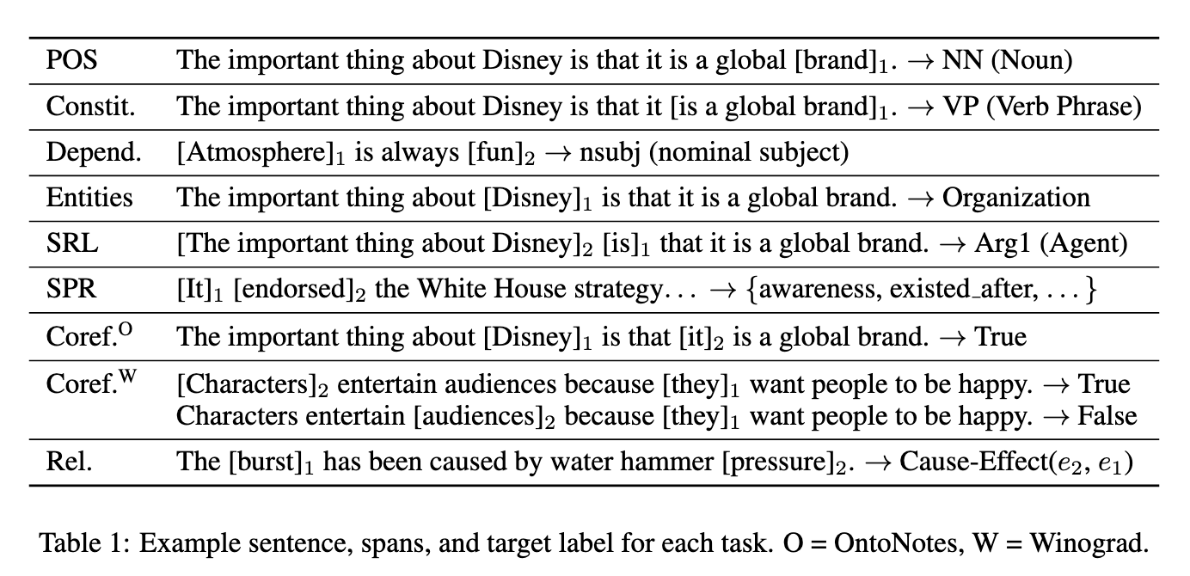
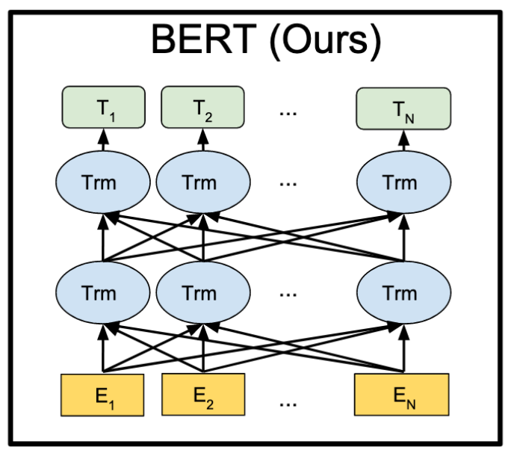
“Old” and “New” Approach to NLP Use Cases
“Old”: Build Models based on Classical “New”: Use BERT (& Similar)
NLP Pipeline
Source: “What Do You Learn from Context? Probing for Sentence Structure in Contextualized Word Representations” Tenney et al
Source: Devlin et al
Any relationship? And what type of information is learned in which BERT layers?

Slide 97
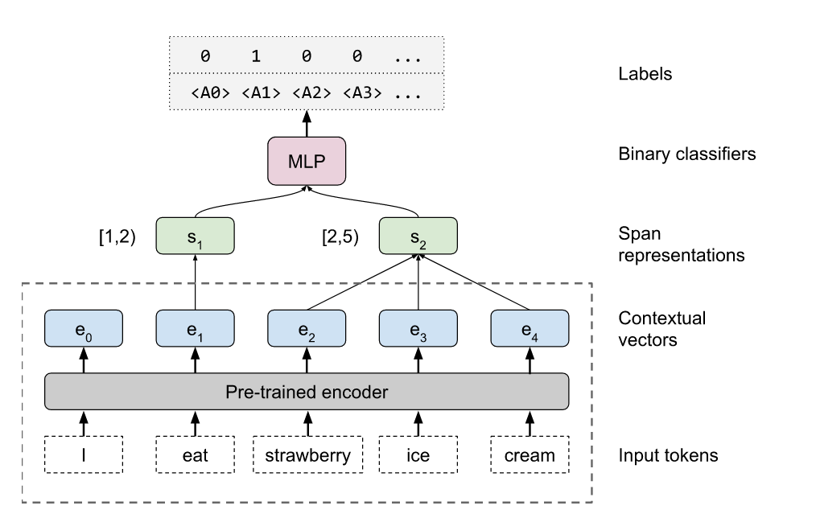
What Types of Sentence Features Are Learned?
“Edge-Probing” Architecture:
Pre-trained encoder with fixed embeddings to be analyzed
Source: “What Do You Learn from Context? Probing for Sentence Structure in Contextualized Word Representations” Tenney et al

Slide 98
What Types of Sentence Features Are Learned?
“Edge-Probing” Architecture:
Learned weights for span pair identification
Pre-trained encoder with fixed embeddings to be analyzed
Source: “What Do You Learn from Context? Probing for Sentence Structure in Contextualized Word Representations” Tenney et al

Slide 99
What Types of Sentence Features Are Learned?
“Edge-Probing” Architecture:
Learned weights for classification of span pair relation
Learned weights for span pair identification
Pre-trained encoder with fixed embeddings to be analyzed
Source: “What Do You Learn from Context? Probing for Sentence Structure in Contextualized Word Representations” Tenney et al

Slide 100

What Types of Sentence Features Are Learned?
“Which” embeddings?
Use linear combination of tokens from level 0 to level L with learned weight factors
Metrics? Two!
~ Which layers get the largest weights?
~ At which layer (ignoring everything later) can the language task be completed ‘well’? (‘~ where is biggest bang for the buck for pred task?’)
Source: “What Do You Learn from Context? Probing for Sentence Structure in Contextualized Word Representations” Tenney et al

Slide 101
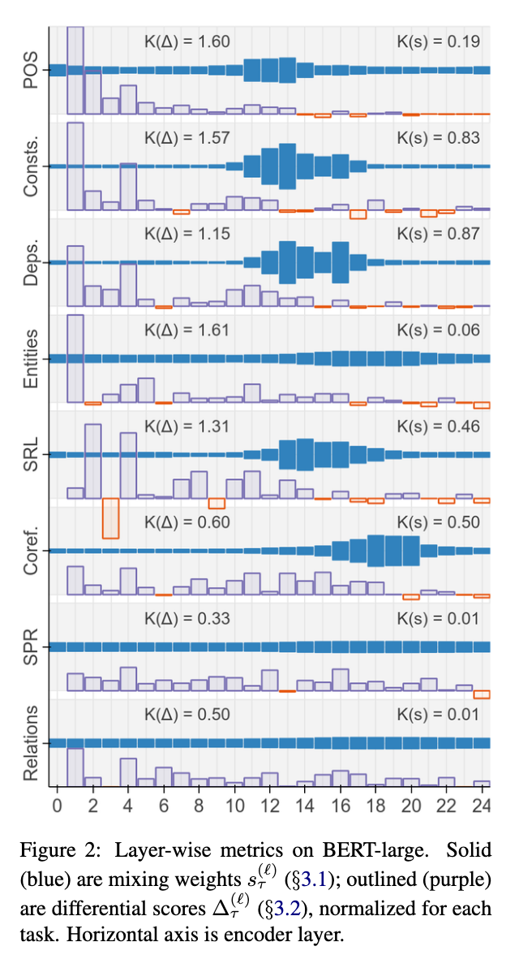
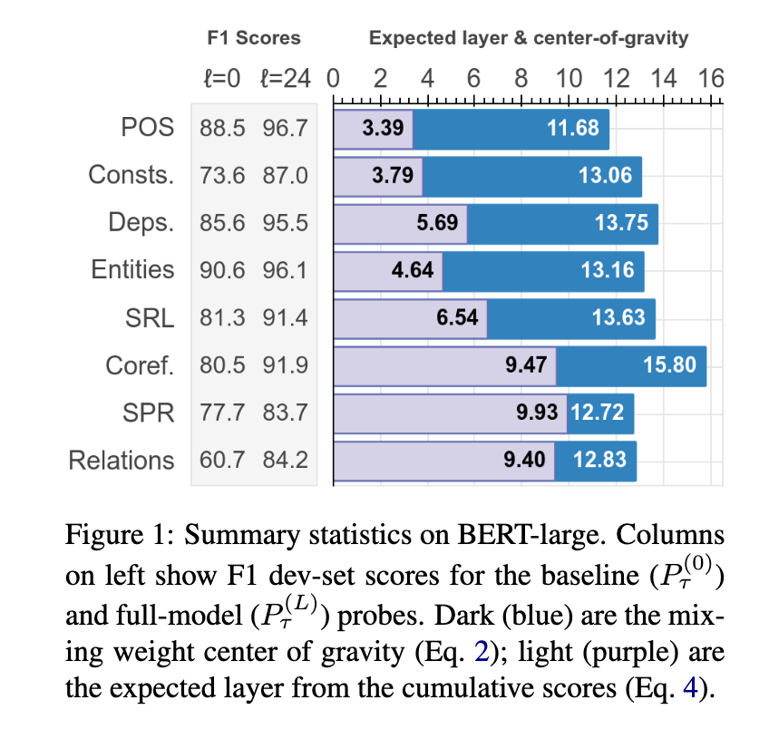
Contextual Embeddings & Sentence Structures
Main Take-Aways:
Context-based embed- dings do learn about linguistic structures
POS comes “early”, more Complex aspects are learned in later layers
“BERT Rediscovers the Classical NLP Pipeline”, I. Tenney et al, Google. See details for metrics, etc.

